Slide 1
SPIRAL MODEL

Slide 2

Hello!
We are a team,
Alok kumar pandya
Venugopala
Gous

Slide 3
Instructions for use
SDLC
SPIRAL MODLE IS A PART OF SDLC
SDLC(SOFTWARE DEVELOMENT LIFE CYCLE)
AND further COMES UNDER
JAD(JOINT APPLICATION DEVELOPMENT)
STAGES /PHASES OF SDLC
SDLC-IT IS A STEP BY STEP PROCESS TO DEVELOP A SOFTWARE.
STEPS
1 REQUIREMENT COLLECTION
2 FEASIBILITY STUDY(PM,BA,AR,FM,HR)
3 DESIGN(HLD &LLD)
4 CODING
5 TESTING
6DEPLOYMENT

Slide 4
JAD and SPIRAL MODEAL
1
Let’s start with the first set of slides
JAD(JOINT APPLICATION DEVELOPMENT)

Slide 5
SPIRAL MODUEL-IT IS A STEP BY STEP OR STANDARD PROCESS TO DEVELOP A SOFTWARE
WHEN EVER WE ARE CONFIRMED ABOUT THE REQ OF 1ST
CYCLE AND WE DON’T HAVE ALL IDEAS ABOUT THE 2ND CYCLe. AND WE WILL GO FOR SPIRAL MODEL WHEN EVER THERE IS A DEPENDENCY BETWEEN TWO MODULE
.

Slide 6
When we go for Spiral model???
Where the project is large
Where the amount of risk is large
Where requirement are complicated
When there is a significant changes in requirement
Where releases are required to be frequently

Slide 7
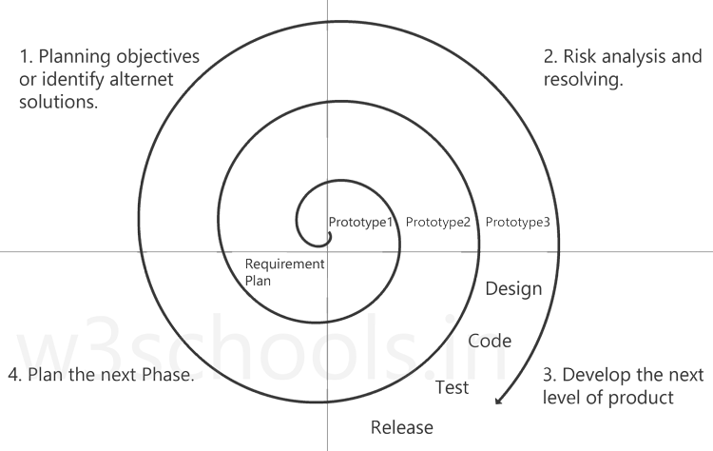
BIG CONCEPT
1.Planning
2.Risk analysis and resolving
3. Develop the next level of product
4.Review and Plan the next phase

Slide 8
Working of Spiral Model…
Planning: Requirements are gathered from the customers and the objectives are identified, elaborated, and analyzed at the start of every phase. Then alternative solutions possible for the phase are proposed in this quadrant.
Risk analysis and resolving: During the second quadrant, all the possible solutions are evaluated to select the best possible solution. Then the risks associated with that solution are identified and the risks are resolved using the best possible strategy. At the end of this quadrant, the Prototype is built for the best possible solution.
Develop the next level of product: During the third quadrant, the identified features are developed and verified through testing. At the end of the third quadrant, the next version of the software is available.
Review and plan for the next Phase: In the fourth quadrant, the Customers evaluate the so far developed version of the software. In the end, planning for the next phase is started

Slide 9
RISK
Risk Handling in Spiral Model
A risk is any adverse situation that might affect the successful completion of a software project. The most important feature of the spiral model is handling these unknown risks after the project has started. Such risk resolutions are easier done by developing a prototype. The spiral model supports coping up with risks by providing the scope to build a prototype at every phase of the software development.

Slide 10

Prototype?
The Prototyping Model supports risk handling, but the risks must be identified completely before the start of the development work of the project. But in real life project risk may occur after the development work starts, in that case, we cannot use the Prototyping Model. In each phase of the Spiral Model, the features of the product dated and analyzed, and the risks at that point in time are identified and are resolved through prototyping. Thus, this model is much more flexible compared to other SDLC models.

Slide 11
Advantages and Disadvantages In two columns ☺
Advatages
The spiral model uses the approach of the Prototyping Model by building a prototype at the start of each phase as a risk-handling technique.
Good for large projects: It is recommended to use the Spiral Model in large and complex projects.
Flexibility in Requirements
Customer Satisfaction
Disadvantages
Complex: The Spiral Model is much more complex than other SDLC models.
Expensive: Spiral Model is not suitable for small projects as it is expensive. Too much dependability on Risk Analysis: it is going to be a failure to develop a project using this model.
Difficulty in time management: As the number of phases is unknown at the start of the project, so time estimation is very difficult.

Slide 12
THANKS!
Any questions?

